Slide 1


eK9 Smart Metal Detector
Paulius Miliunas
Software and Electronics Engineering

Slide 2

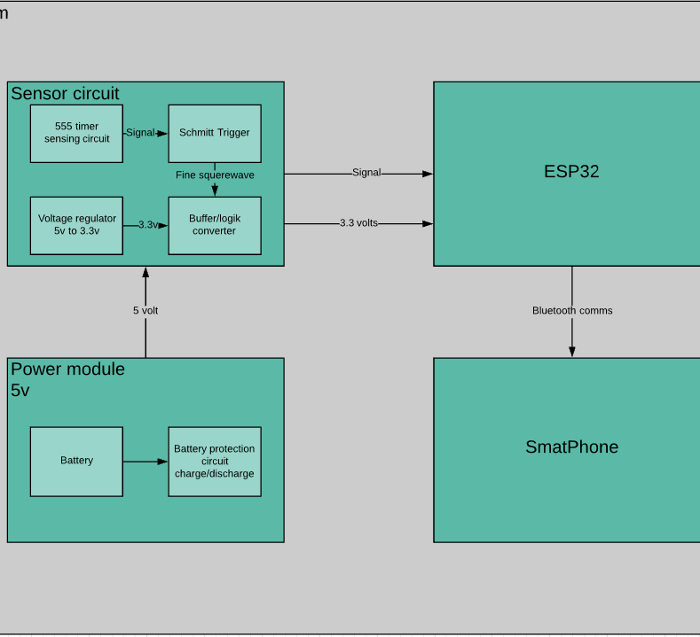
eK9 Block Diagram

Slide 3
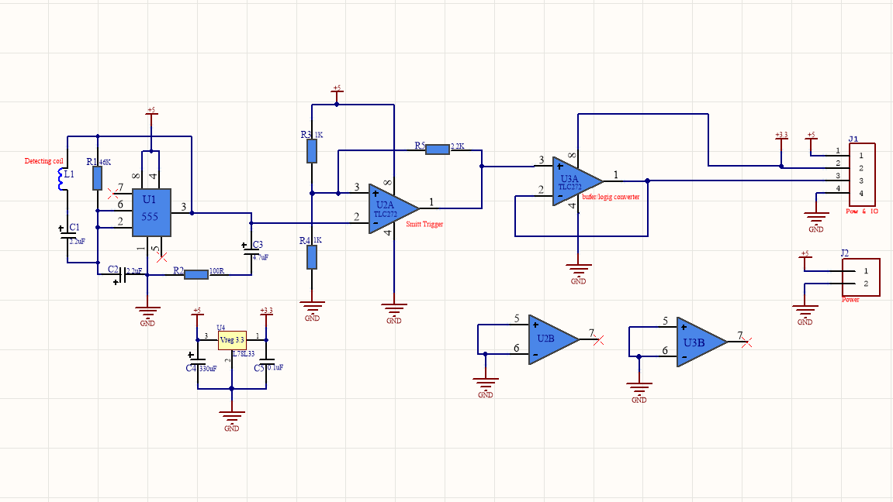
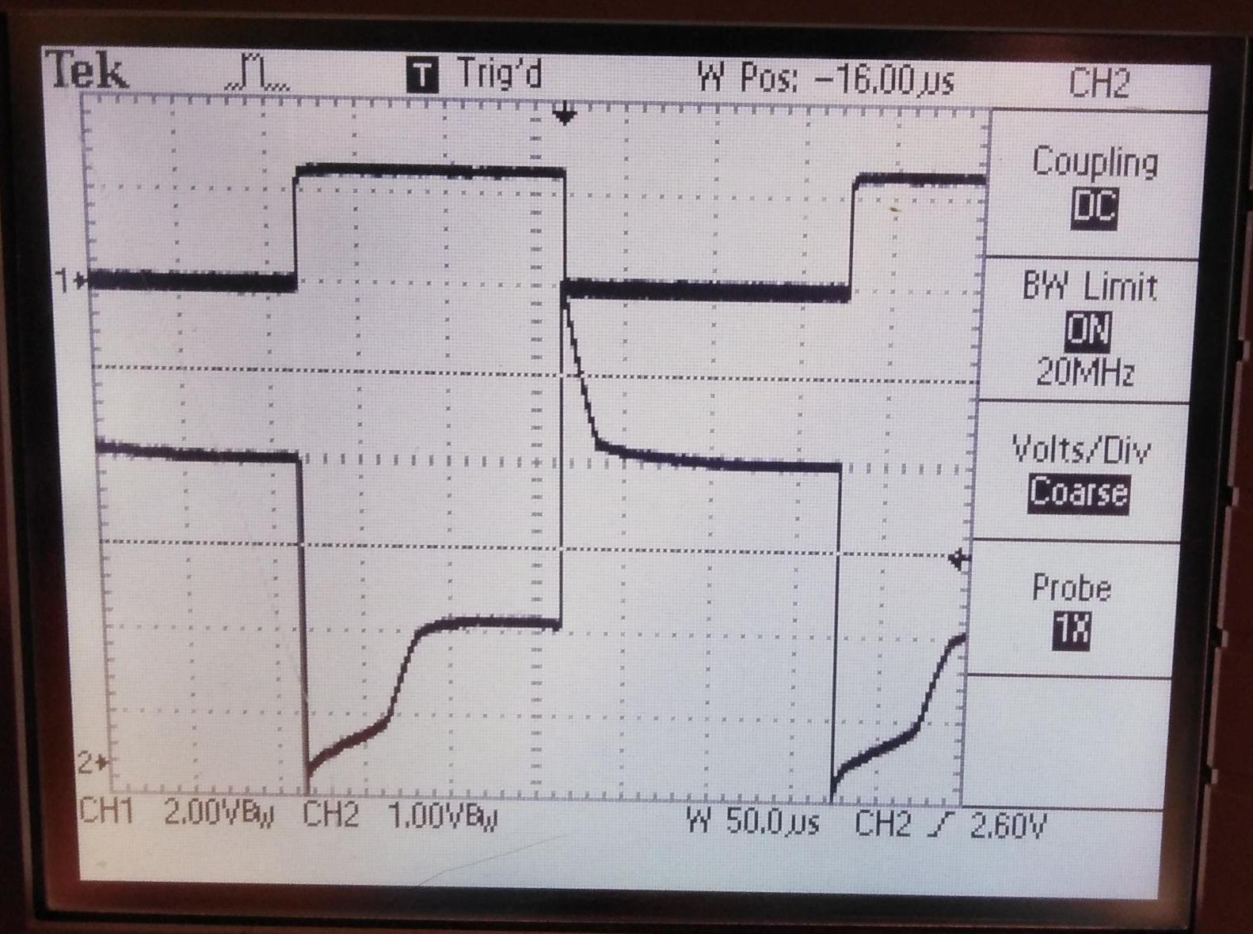
Detector Hardware
Metal Detecting circuit uses 555 timer and 2 op-amps. U2 op-amp is used as smith trigger, and U3 op-amp is used as buffer for converting logic voltages for esp32.

Slide 4
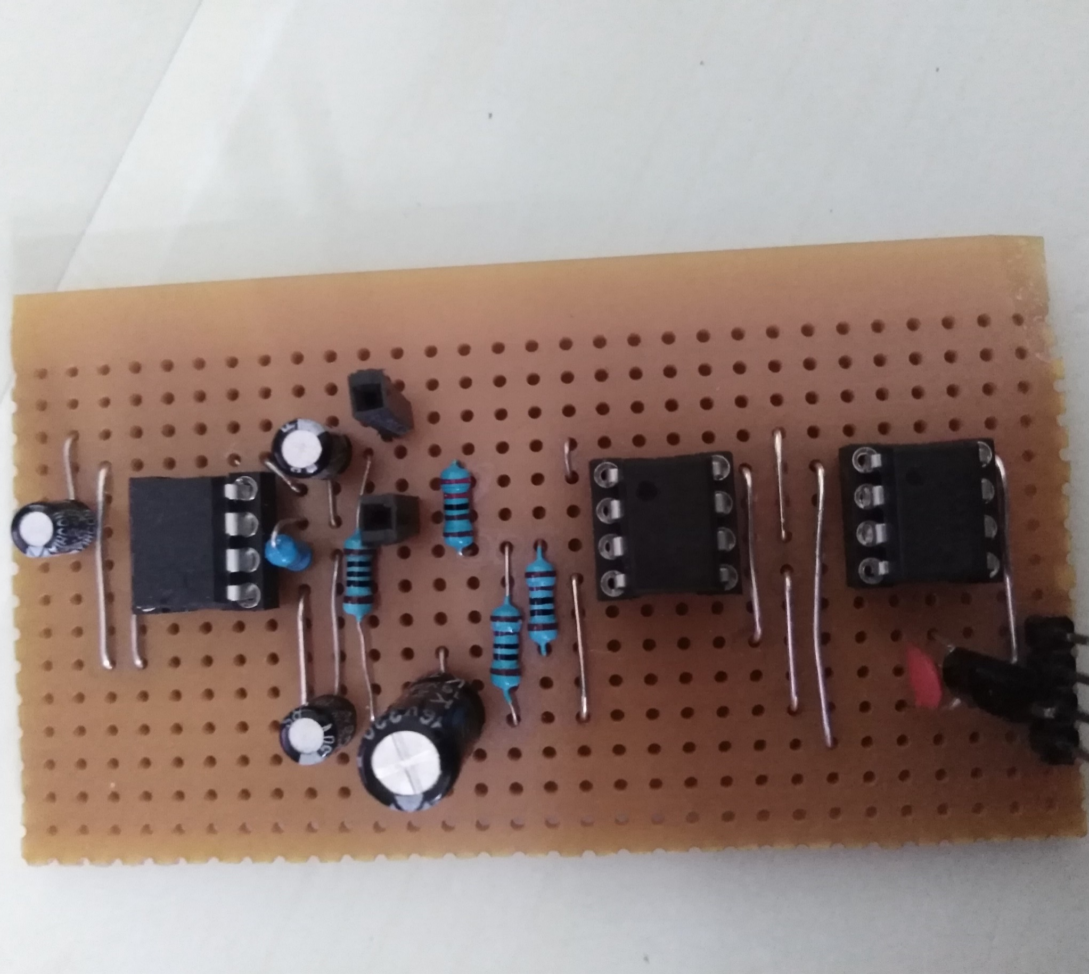
Prototype Build
Prototyped board runs of 5v
Have voltage regulator to power up MCU
When running uses 500mA

Slide 5
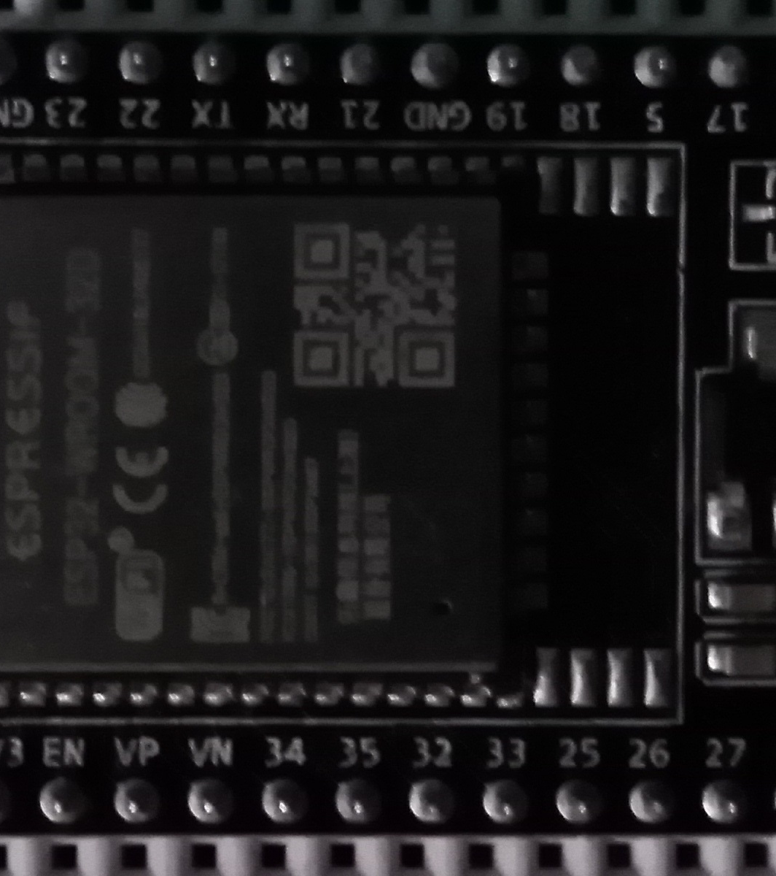
The Brain of eK9
MCU configured to detect falling edge of signal and on interrupt take time stamp
MCU calculates frequency and sends vie Bluetooth to smartphone

Slide 6
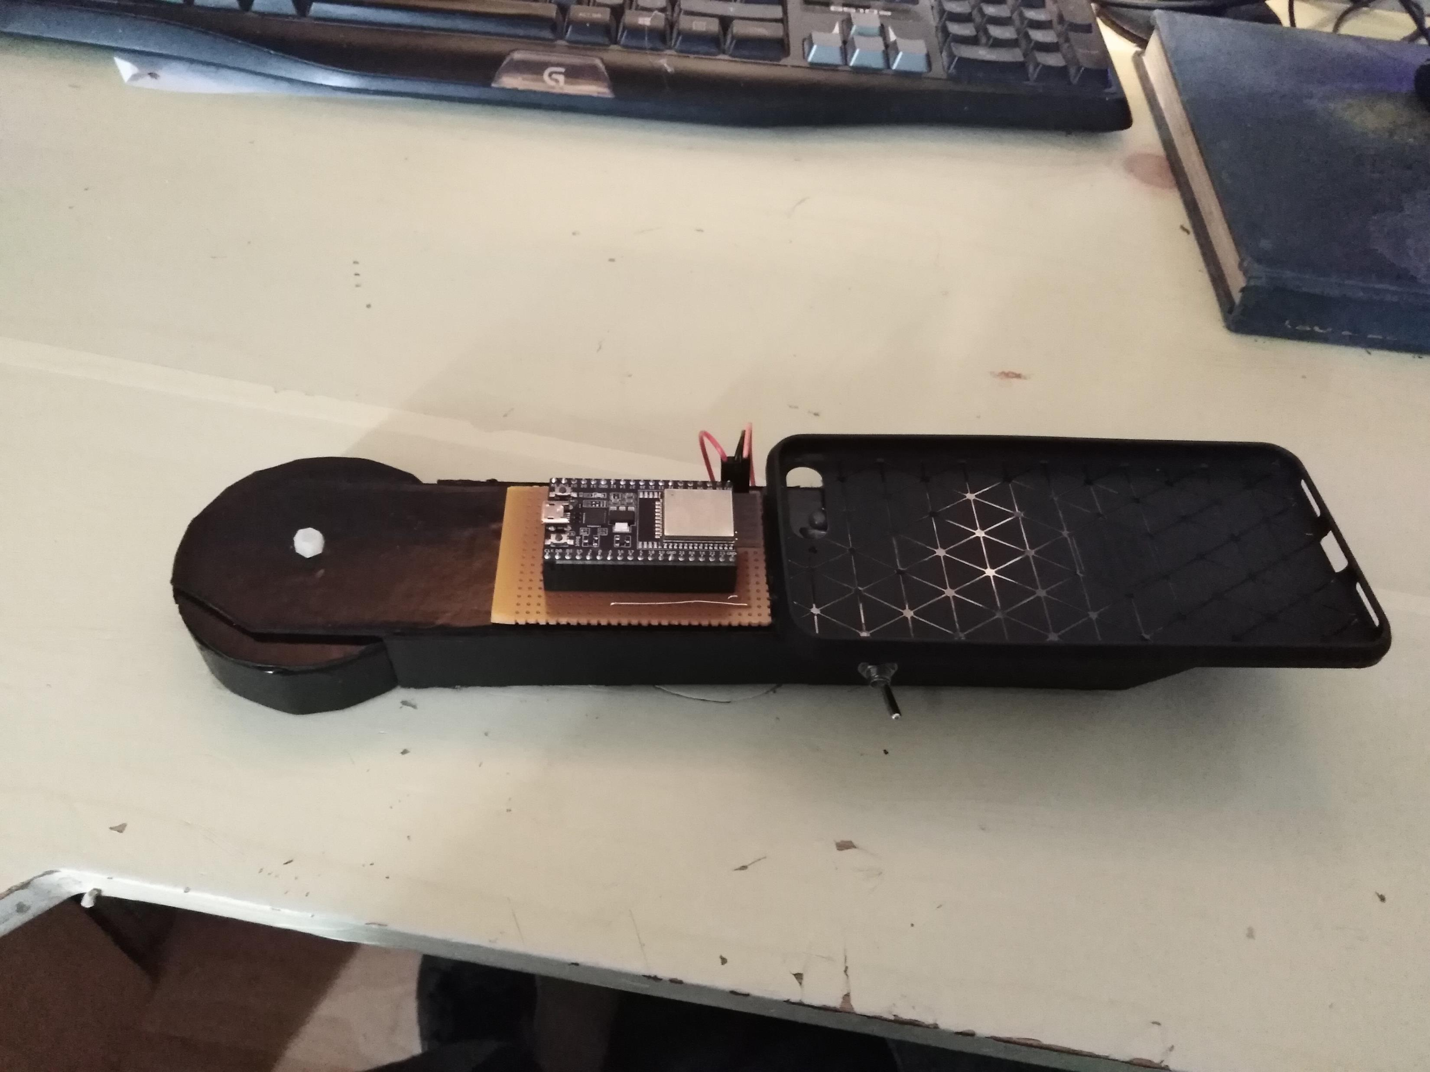
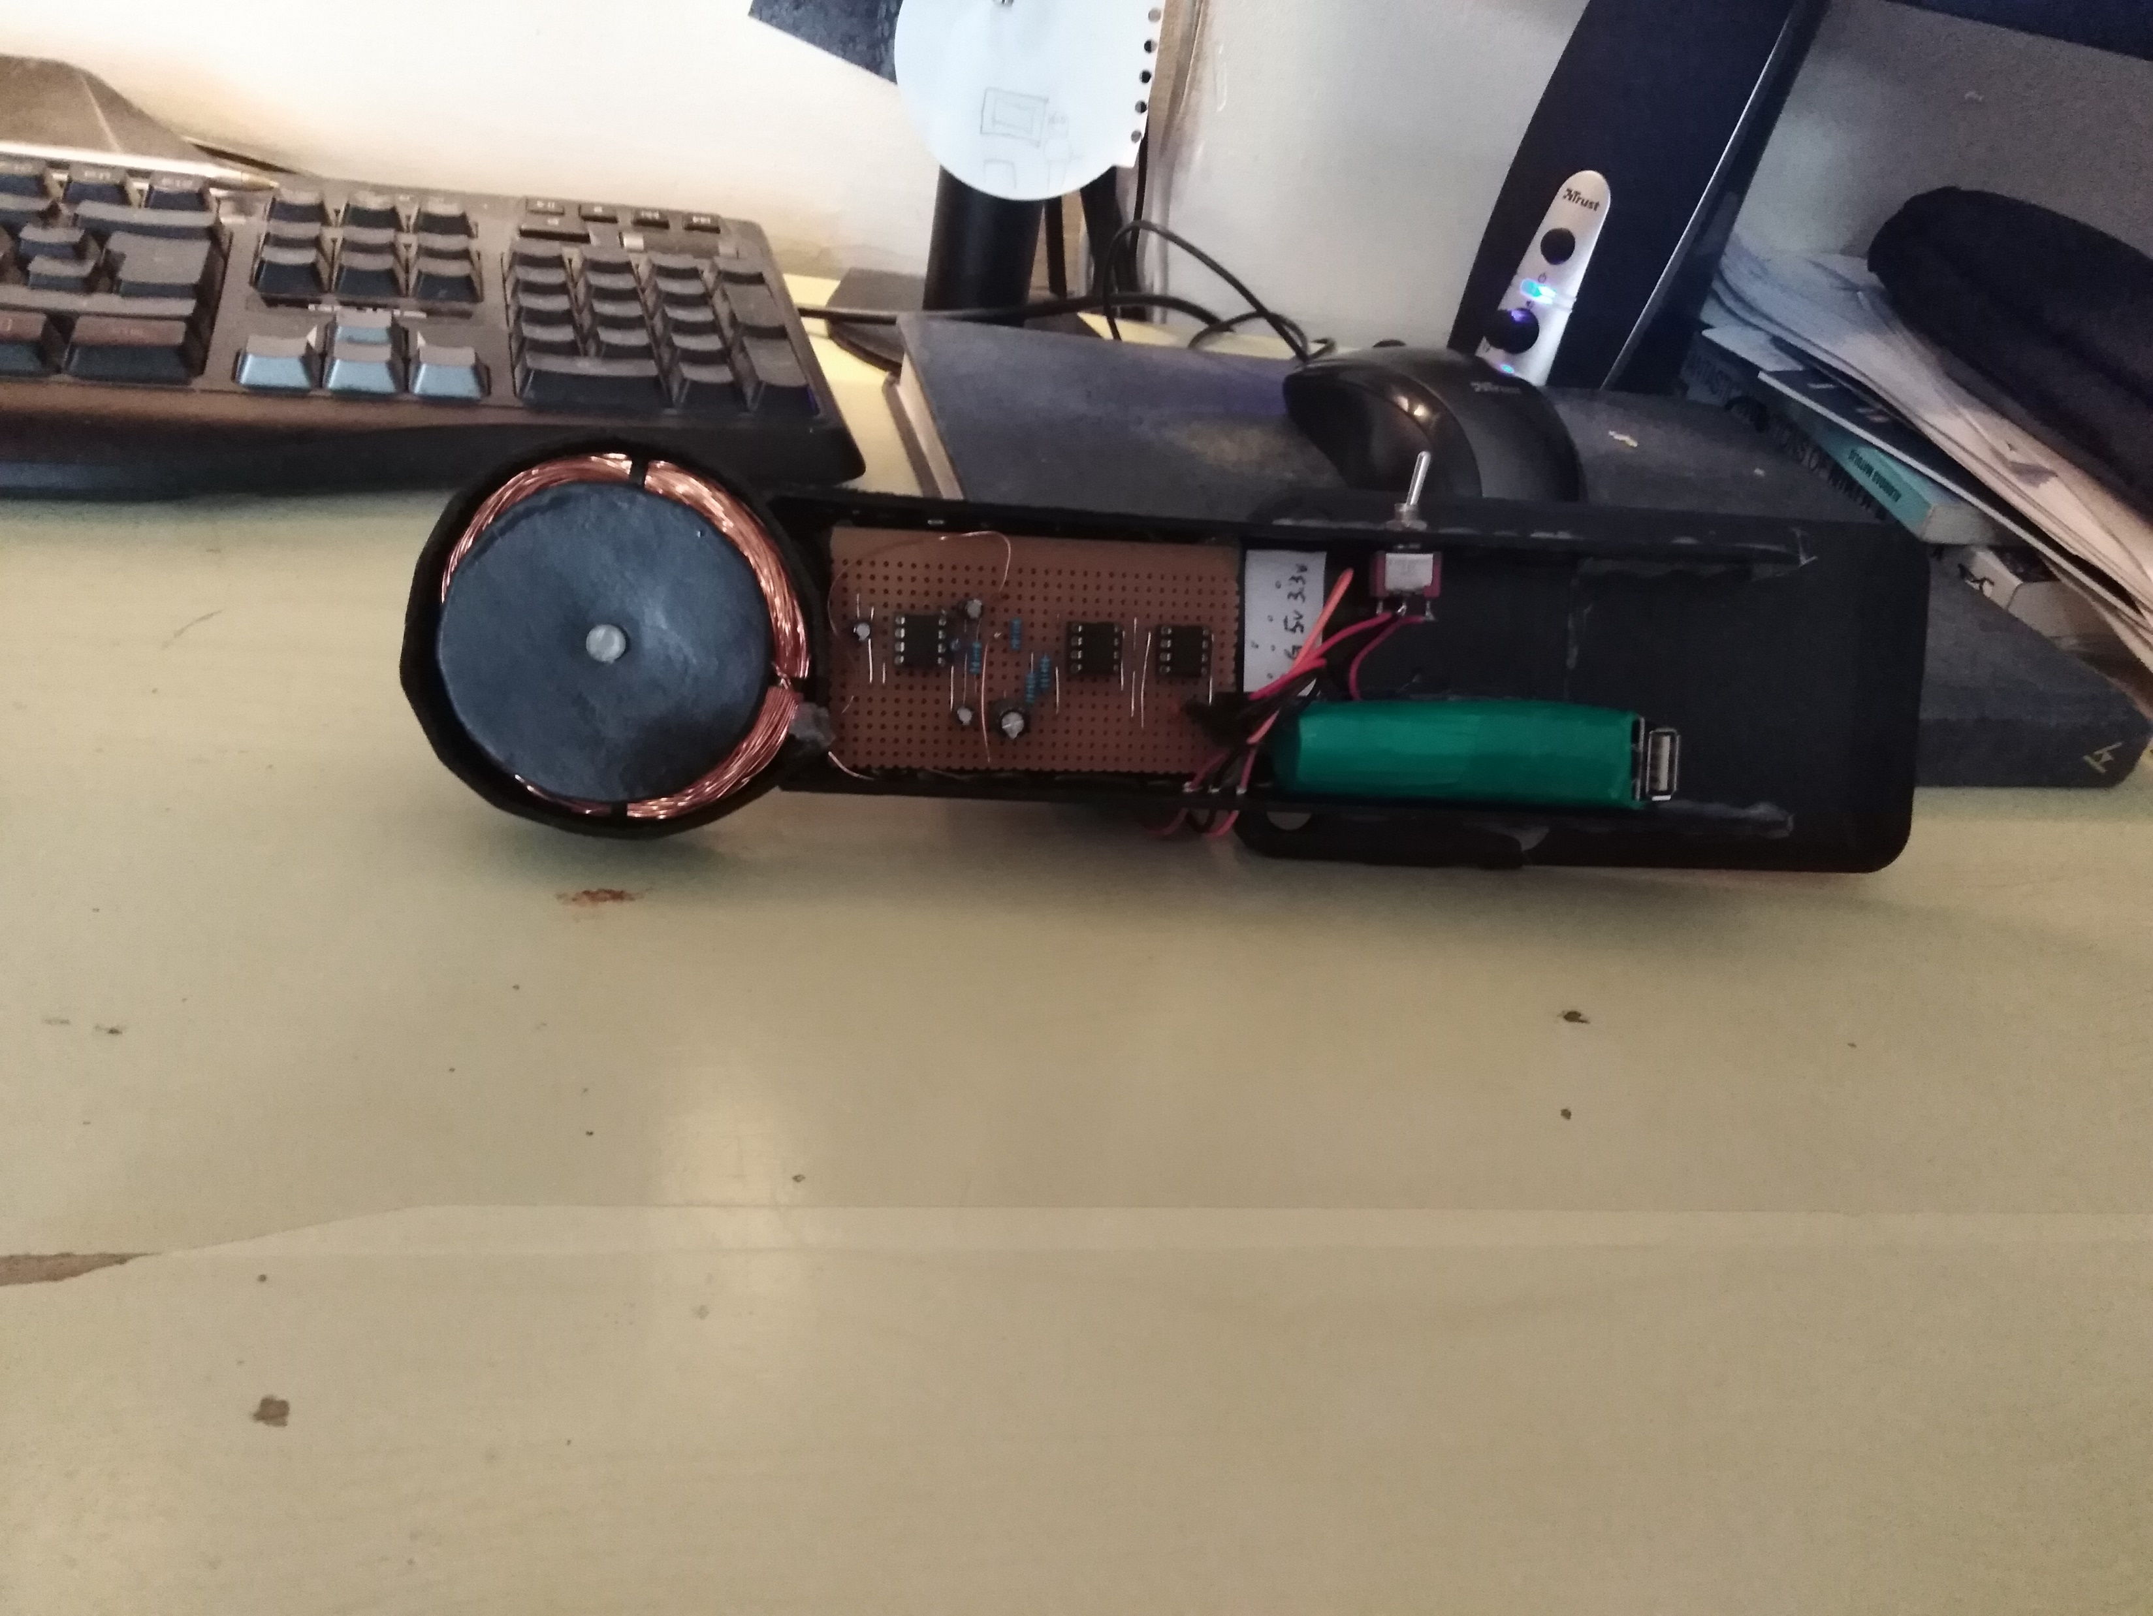
eK9 enclosure
All system build in one frame
Smart Phone can be attached to enclosure
Rechargeable battery attached with battery protection circuit

Slide 7
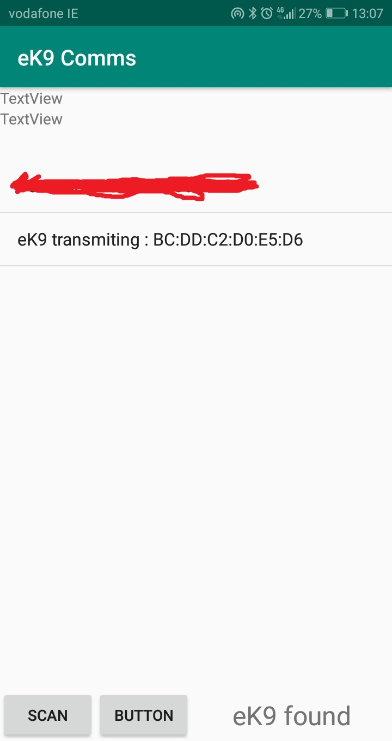
eK9 Comms App
Bluetooth communication
App running on android can receive data from eK9 device
App will be notified about frequency change and react as instructed.

Slide 8
Thank You
Any questions

